Slide 1

Banking Management System
Team Members
Amrit Tamang (THA080BEI006)
Abishek Sitaula (THA080BEI002)
Aditya Shrestha (THA080BEI003)
Chhantalal Giri (THA080BEI017)
Department of Electronics and Computer Engineering
Institute of Engineering
Thapathali Campus
May 5, 2024

Slide 2
Presentation Outline
Introduction
Motivation
Objectives
Scope Of Project
Methodology
Result
Gantt Chart
Future Enhancements

Slide 3
Introduction
Banking System:
We all are very familiar to the banking system and it is one of the most important system, handling the modern economy. Similar to that our banking system has got some of the features of it like transfer, deposit, withdrawal option with the signing up and logging in features, in our system.

Slide 4
Motivation
When assigned this task, our aim was to find an interesting project suitable for implementation in C. We sought something both practical and familiar in our day-to-day experiences. After brainstorming and investigation, we ultimately chose to develop a Bank Management System.

Slide 5
Objectives
To design a user friendly menu-based interface that works properly with no errors and bugs.
To make it easy for the users to do money related activities.
To learn about structure, array and file handling in C.
To work as a team and develop team work.

Slide 6
Scope Of Project
To create a real-life and practical project that can provide the basic mechanism.
To handle the bank account of a user.
To let a user perform various banking activities.
To create a small replica of the banking system in our own way.
To facilitate user offering options to create and work with the account.

Slide 7
Methodology
Login and sign up module to operate safely.
Various users data are stored safely and can be retrieved when required.
Options for the user to deposit, transfer and withdraw the money from own accounts.
Password system so it also focuses on the security.
Data loss is prevented and every transaction effects the users balance in account.

Slide 8
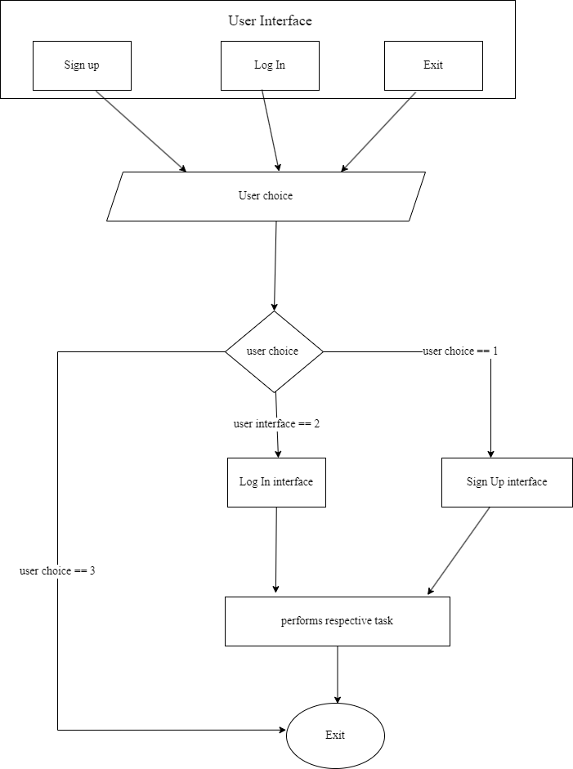
Block Diagram

Slide 9
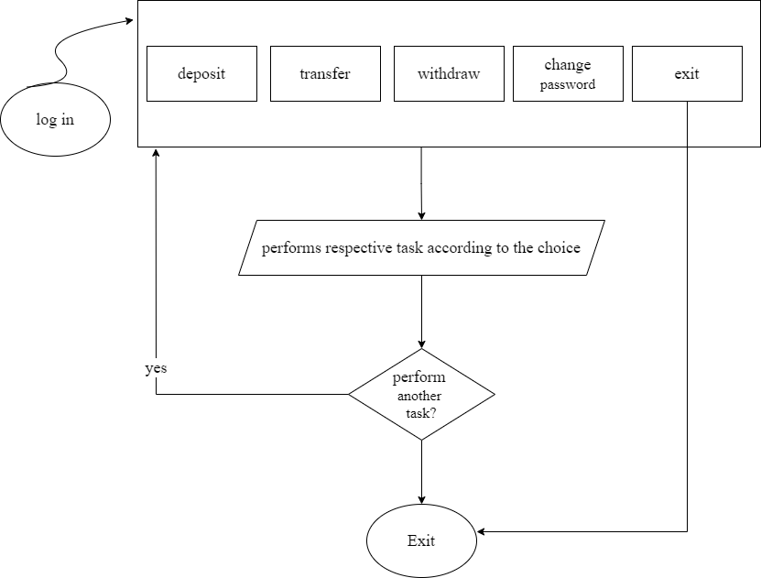
Login page

Slide 10
Instrumentation
VS code Editor: We used visual studio code to write the program with its’s different extension on it.
GCC: GCC is a compiler used for compiling C and C++ program and it stands for GNU Compiler Collection
GitHub: We used github to share our program with each other as it provides a platform to manage our code.

Slide 11
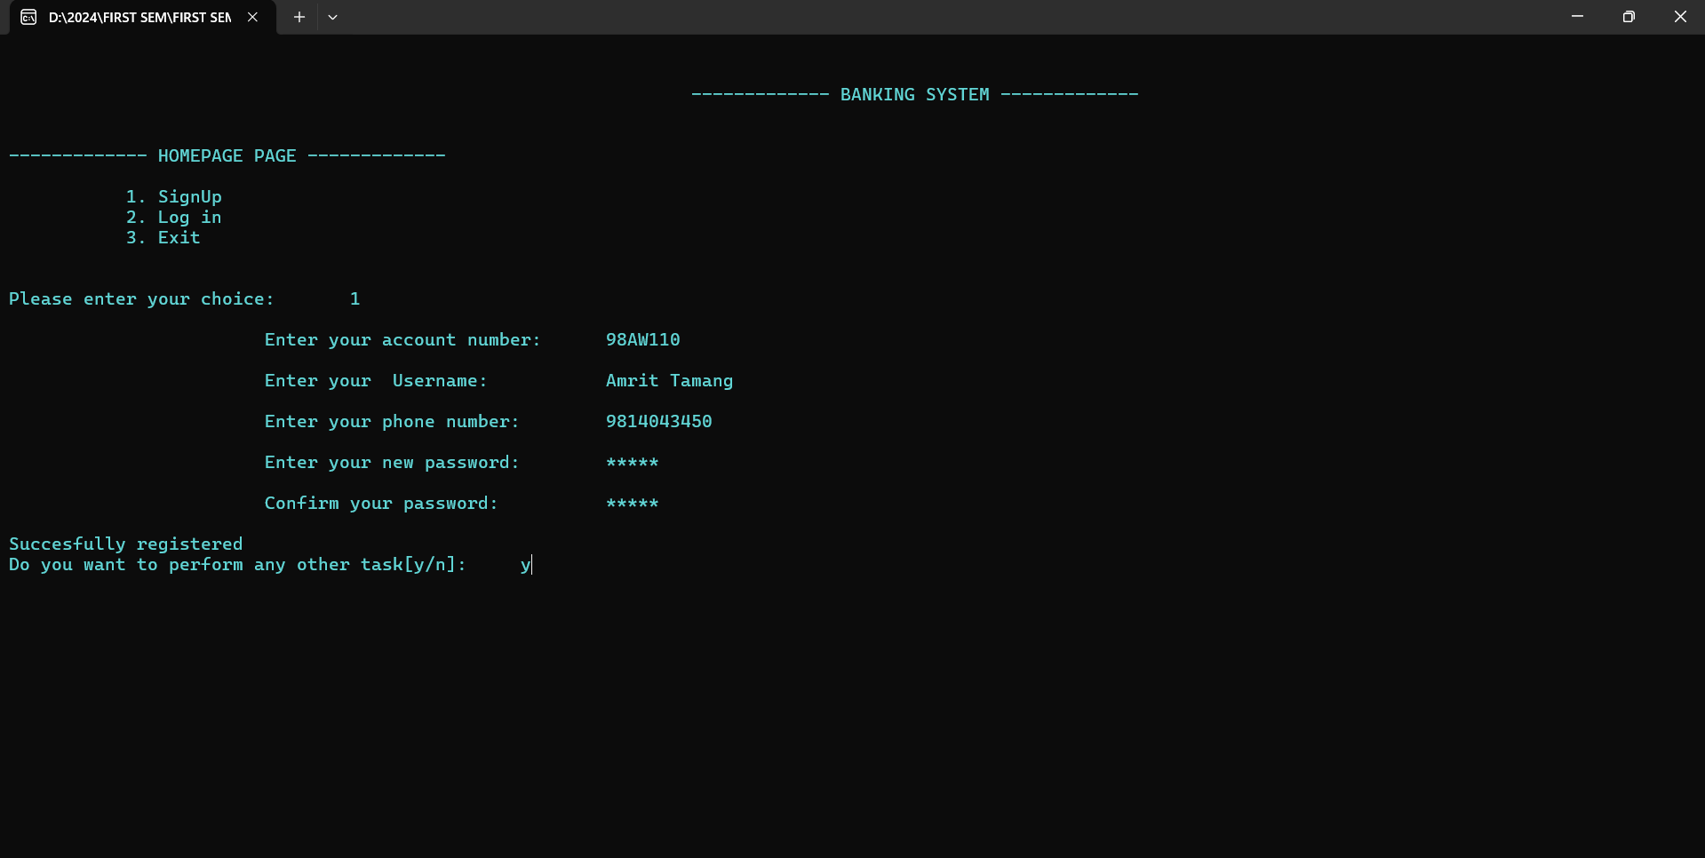
RESULTS

Slide 12
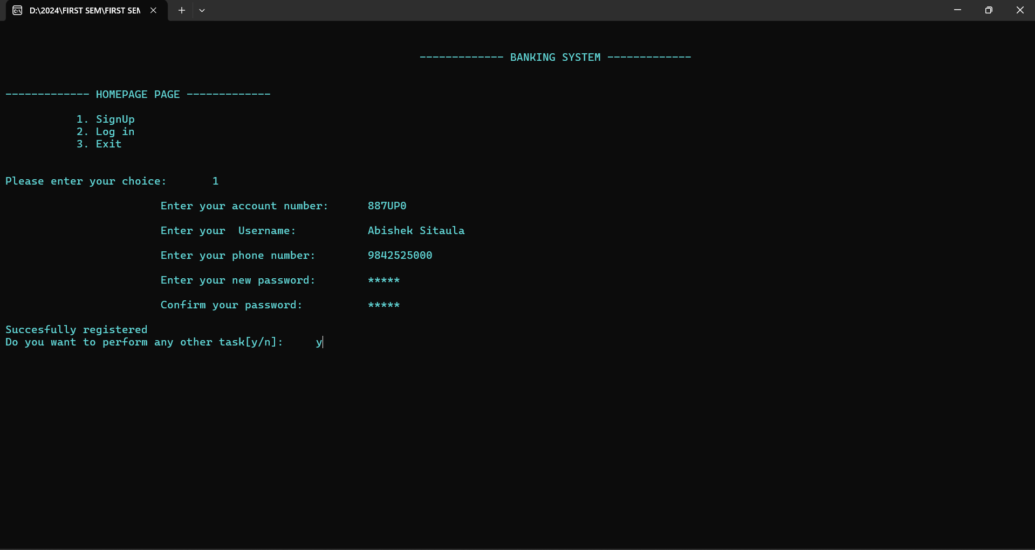

Slide 13
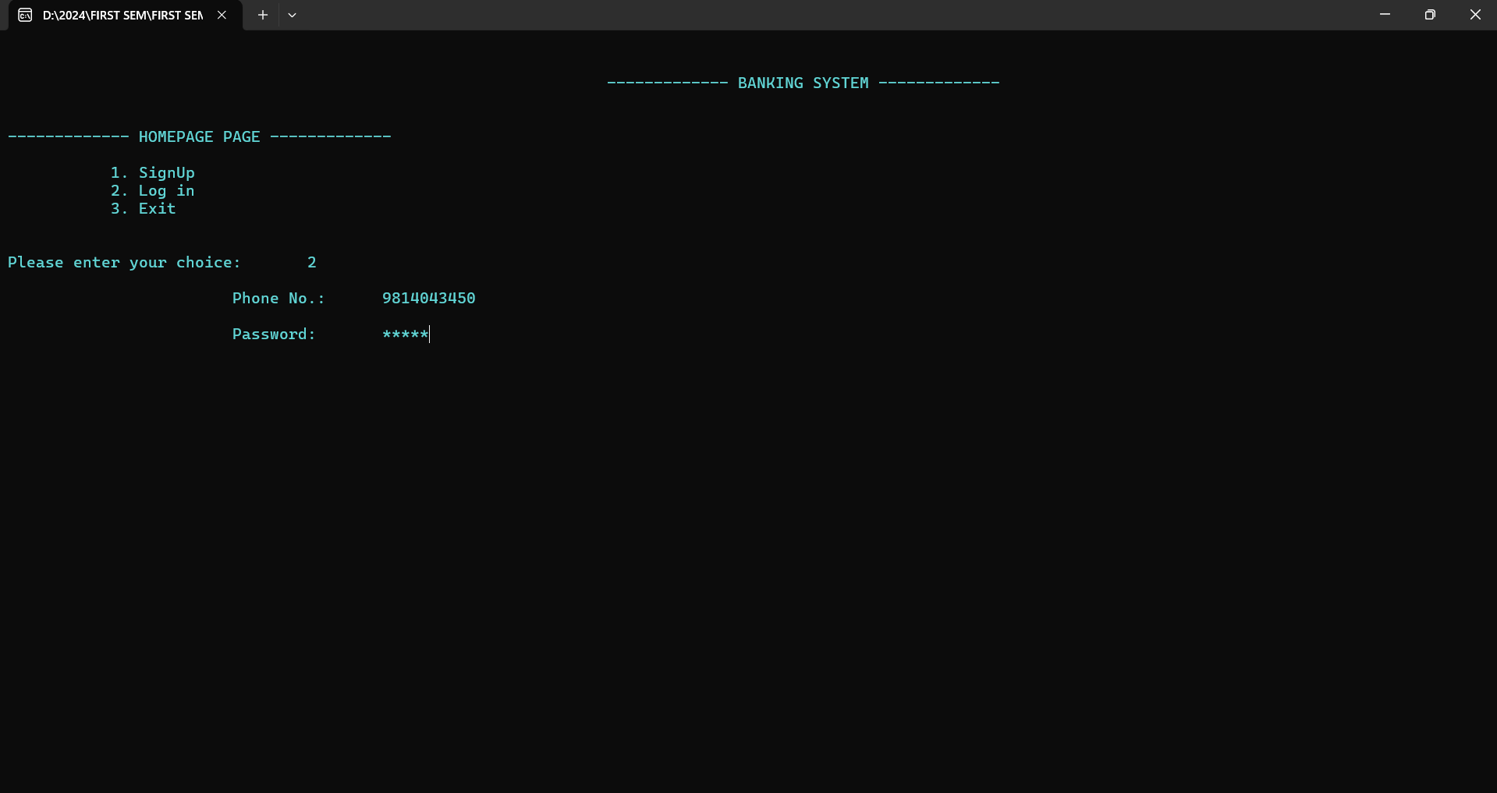

Slide 14
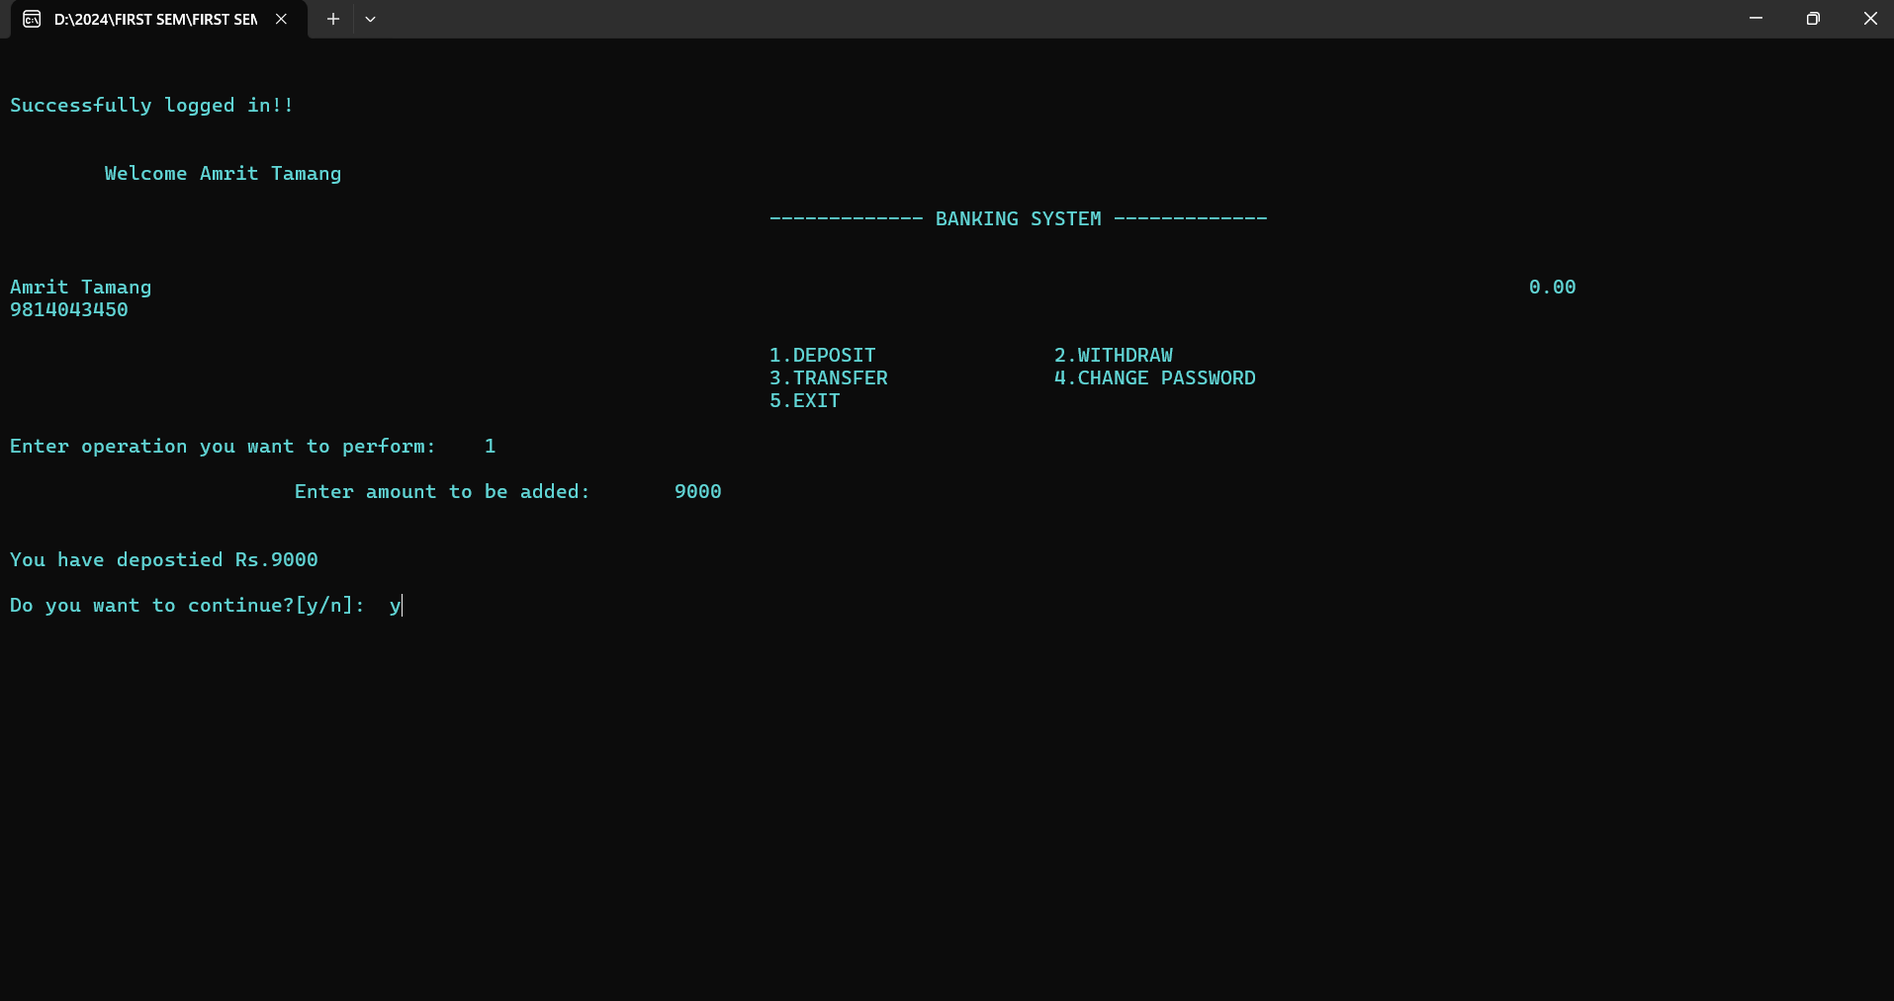

Slide 15
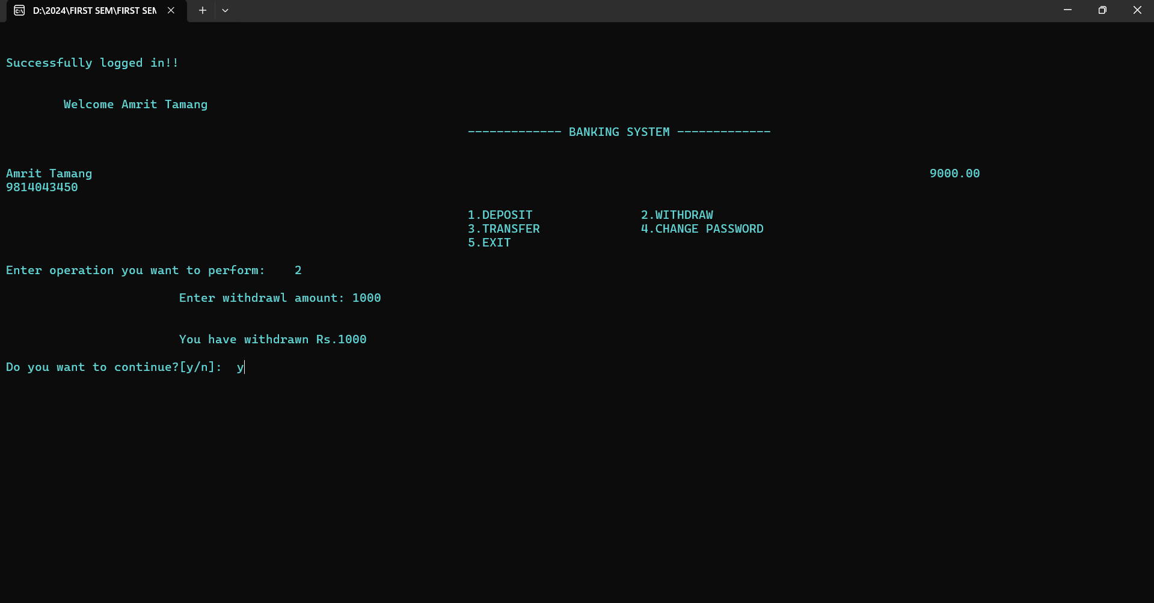

Slide 16
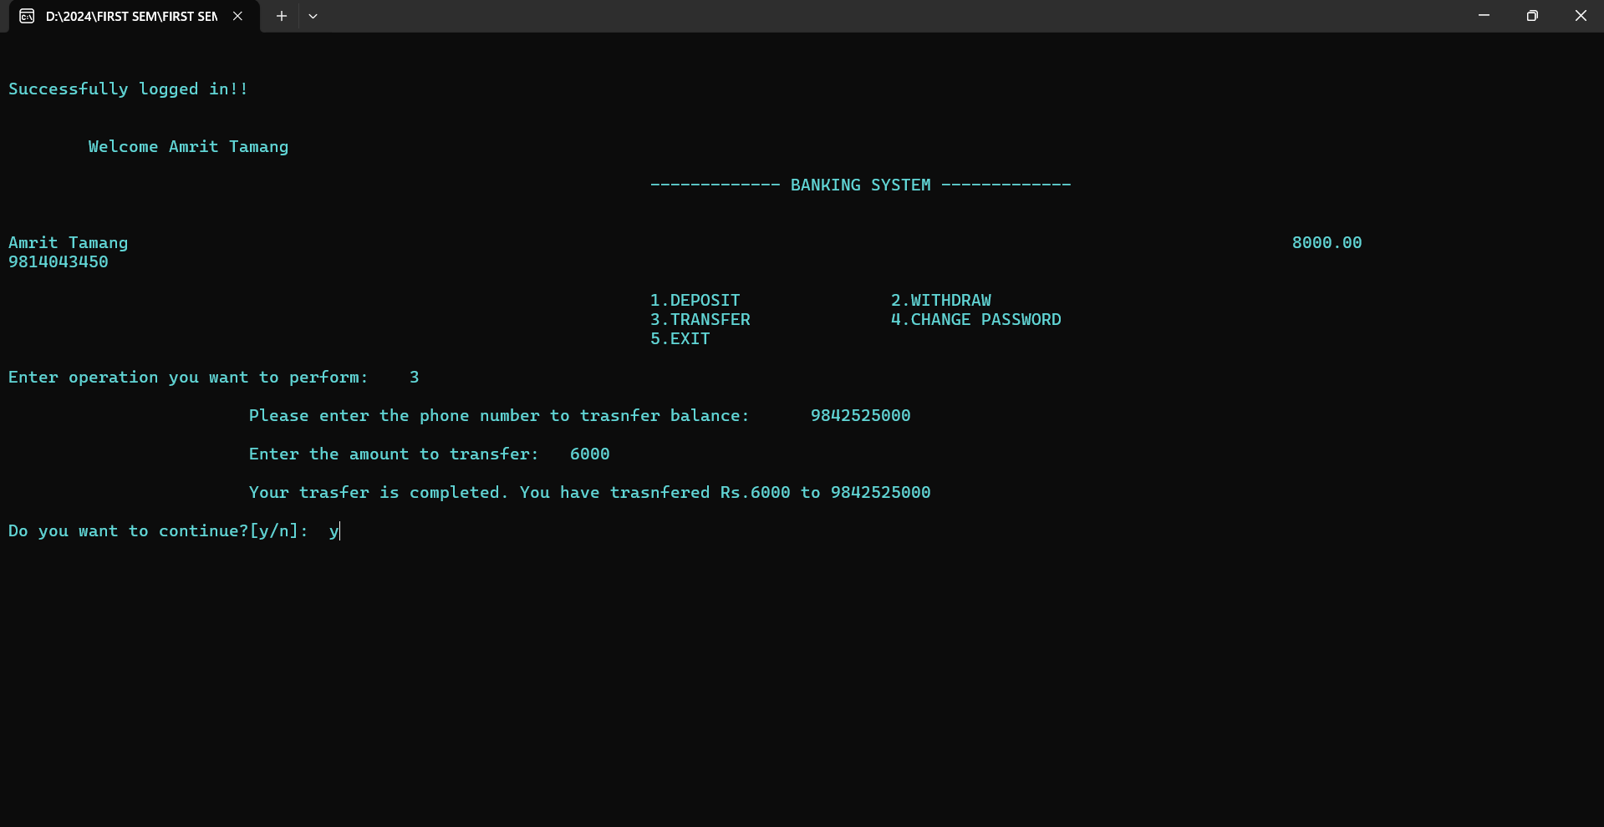

Slide 17
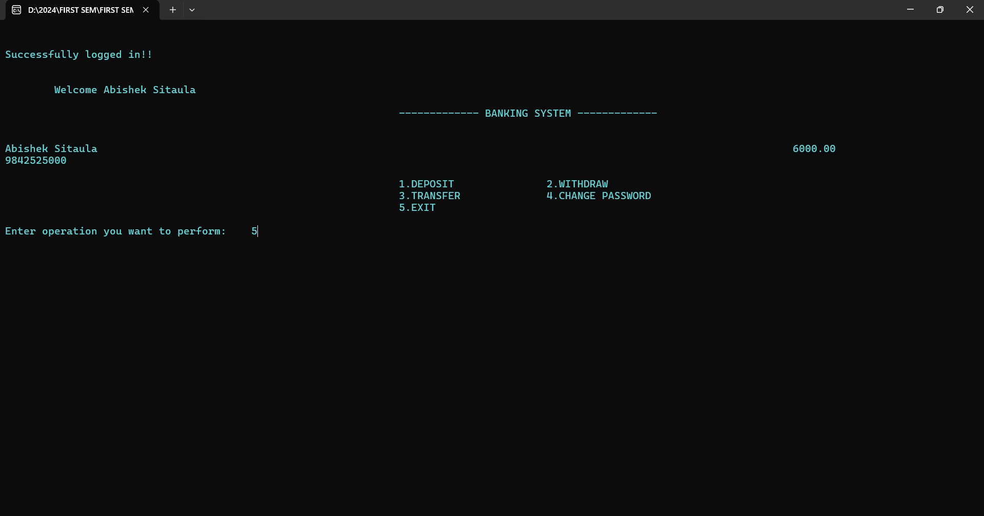

Slide 18
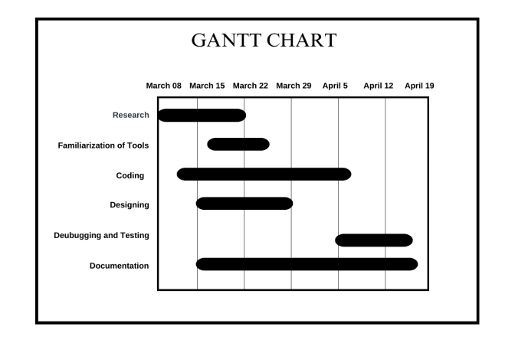
Gantt Chart

Slide 19
Future Enhancements
We can think of the database to store the information.
We can add more features of showing bank transactions.
We can make it more secure.

Slide 20
THANK YOU !!

